Slide 1

Lab5: switch statements; enum datatype
UNT CSCE1030, Spring 2021
TA Polina Nemkova

Slide 2
Options
The lab is due Friday by 11.59pm
WORK BY YOURSELF: This lab instructions are available on Canvas. If you feel comfortable with this assignment, you can do it by yourself. Ask me to check it in the very end before you submit it.
WORK WITH ME: Follow the steps I describe on the slide.

Slide 3
What Do We Need to Submit?
Two files for two tasks:
Lab5A.cpp
Lab5B.cpp

Slide 4
Step1: Prepare the working space
Pull up the .pdf file for Lab5 from your canvas account;
Start Putty (cse01.cse.unt.edu cse02.cse.unt.edu cse03.cse.unt.edu cse04.cse.unt.edu cse05.cse.unt.edu cse06.cse.unt.edu)

Slide 5
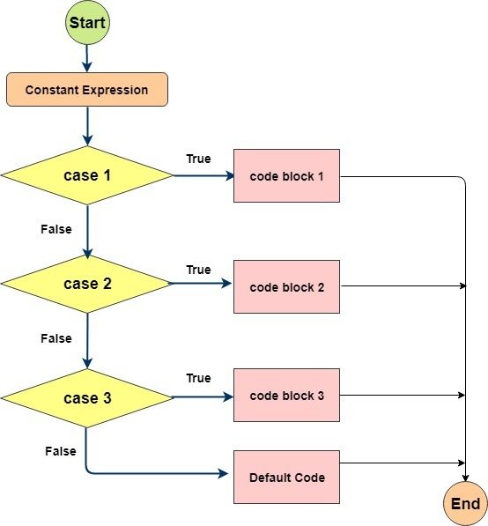
Switch structure

Slide 6
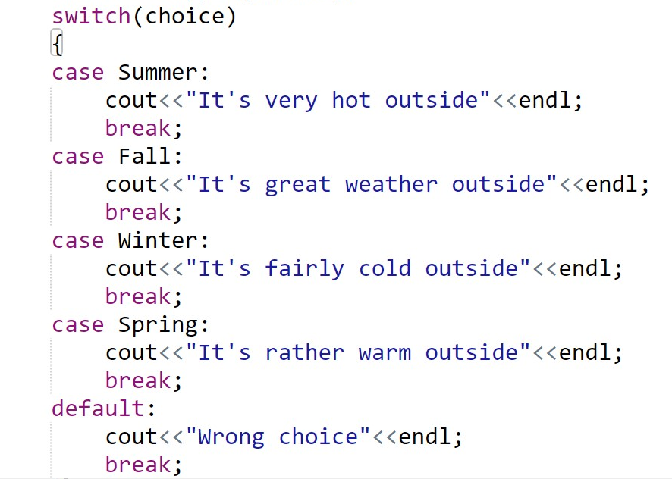
switch syntax

Slide 7
enum datatype
enum Season {Winter='W', Fall='F', Summer='U', Spring='S'};

Slide 8
Submission
Go to WinSCP and copy your files from the CSE machine on your computer.
If you want, show me execution of your programs (to be sure that there is no problems).
Submit Lab4A.cpp, Lab4B.cpp, Lab4C.cpp on Canvas.

